Slide 1

CULTIVATE
MEANINGFUL CONNECTIONS
Unlock year-round, tailored access to the industry’s most powerful global investor network with the 121 Investor Engagement Programme.
Get in touch | ieteam@121mininginvestment.com

Slide 2







PROGRAMME FUNDEMENTALS
We cultivate meaningful connections between mining companies and investors, fueling growth and long-term success across the industry.
Investor engagement advisory
Roadshows support
121 Events Concierge
Dedicated account manager, developing an annual investor engagement strategy tailored to your objectives
Taking your message to a curated list of investors in target locations (virtually and in-person), including meeting co-ordination
Managing your meeting schedule end-to-end from targeted investor outreach to onsite meeting facilitation to post-show investor feedback reports – maximising your ROI
Targeted distribution
Outreach analytics
The Assay exposure
Webinar support
Promoting your news and marketing to the right investors ​on our database based on their specific investment criteria
Providing detailed analytics on investor readership after each distribution announcement – enabling agile targeting
Amplifying your story via The Assay online platform, including news features, profiles, editorials and CEO interviews
Organisation of themed webinars to support major news flow and highlight corporate activities, to further engage with targeted investors globally

Slide 3
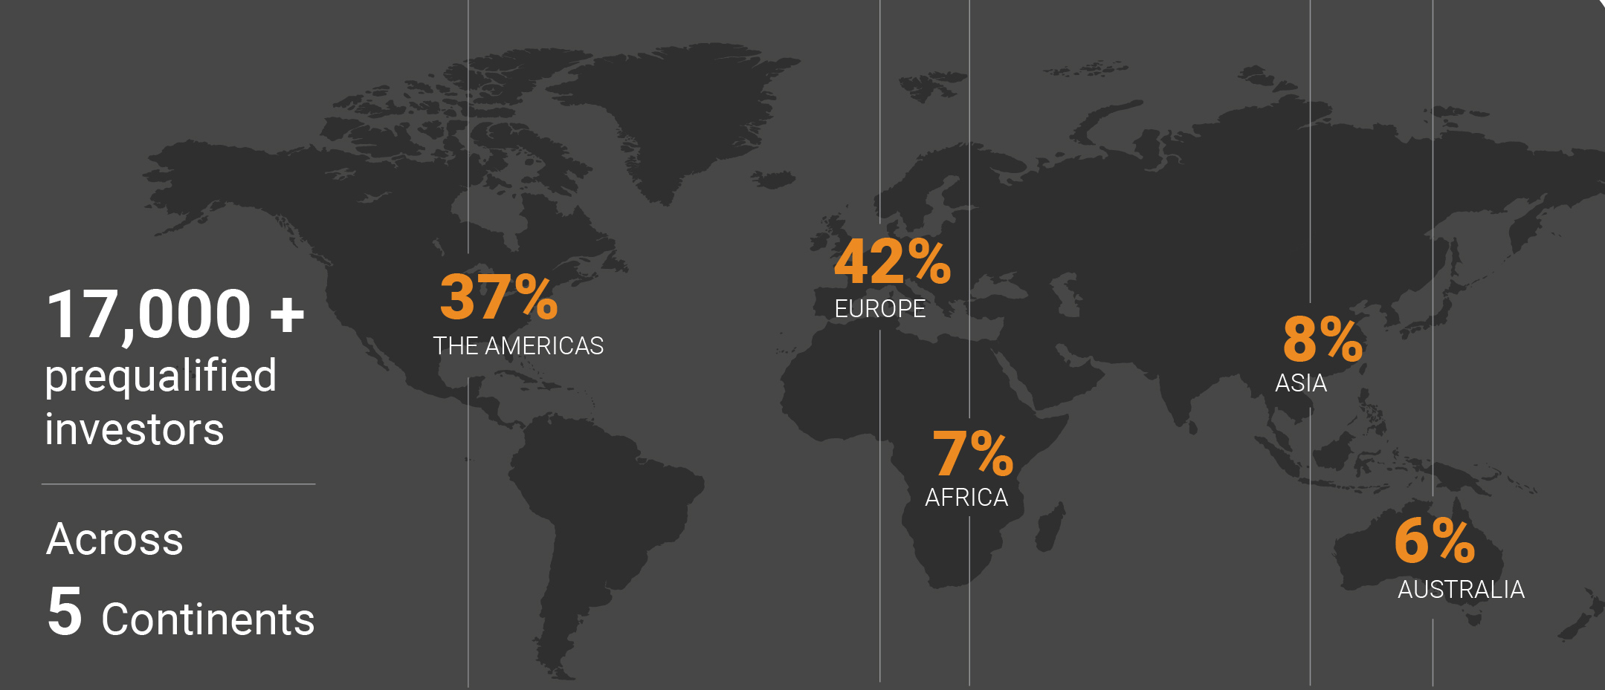
DELIVERING ON
YOUR OBJECTIVES
The Initial Process
Step 1 – Assess your current investor engagement activities
Step 2 - Define your strategic objectives
Step 3 – Complete investor gap analysis
Step 4 – Agree bespoke investment engagement programme
Step 5 – Activate access

Slide 4
YOUR 121 EVENTS CONCIERGE
White glove service before, during and after your selected 121 Mining Investment events, maximising your ROI
AHEAD OF THE EVENT OUR TEAM....
AT THE EVENT OUR TEAM...
AFTER THE EVENT OUR TEAM...
Manages your company profile, ensuring visibility at the earliest opportunity
Carefully handpicks a list of investors aligned with your goals
Builds and manages your meeting schedule, optimising your time onsite
Secures strategic speaker placement in the seminar programme
Provides detailed feedback reports based on one-on-one conversations with your investors to support
Strength of the investment case
Clarity of the strategy
Confidence in management
Amplifies your story through distributing your event content to our global investor networking
Provides full onsite support, including fast track event registration
Monitors and optimises your schedule based on live event updates
Facilitates CEO interviews and key introductions
Benefit from discounted rates across our global series
121 HONG KONG I 11-12 March 2026
121 LONDON I 11-12 May 2026
121 NEW YORK I 15-16 June 2026
121 GLOBAL ONLINE I 13-14 October 2026
121 LONDON I 23-24 November 2026
121 DUBAI I 26-27 November 2026

Slide 5
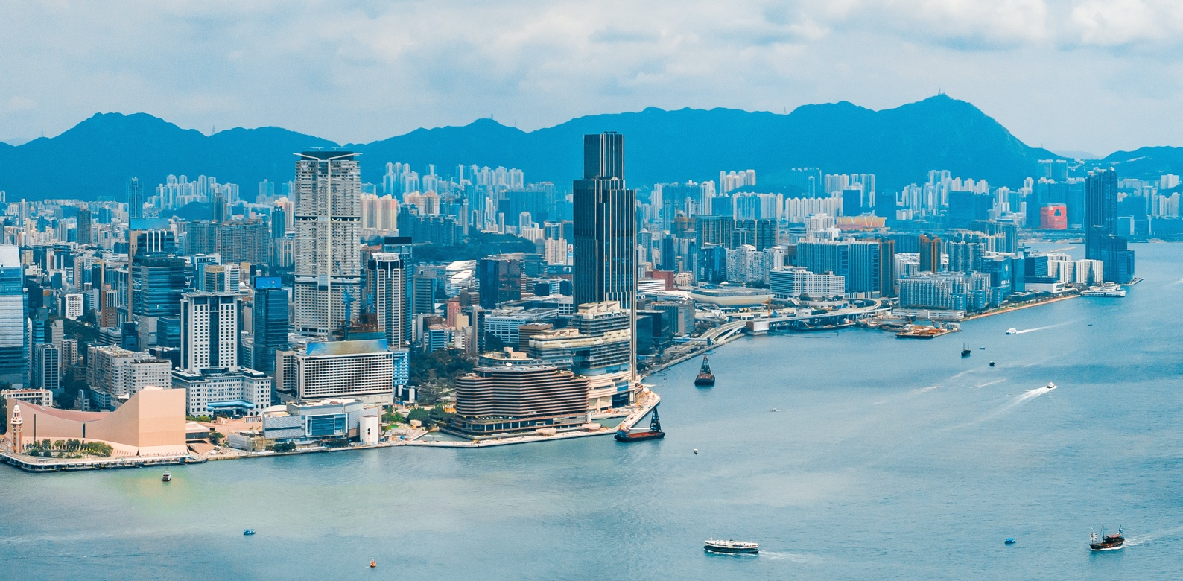

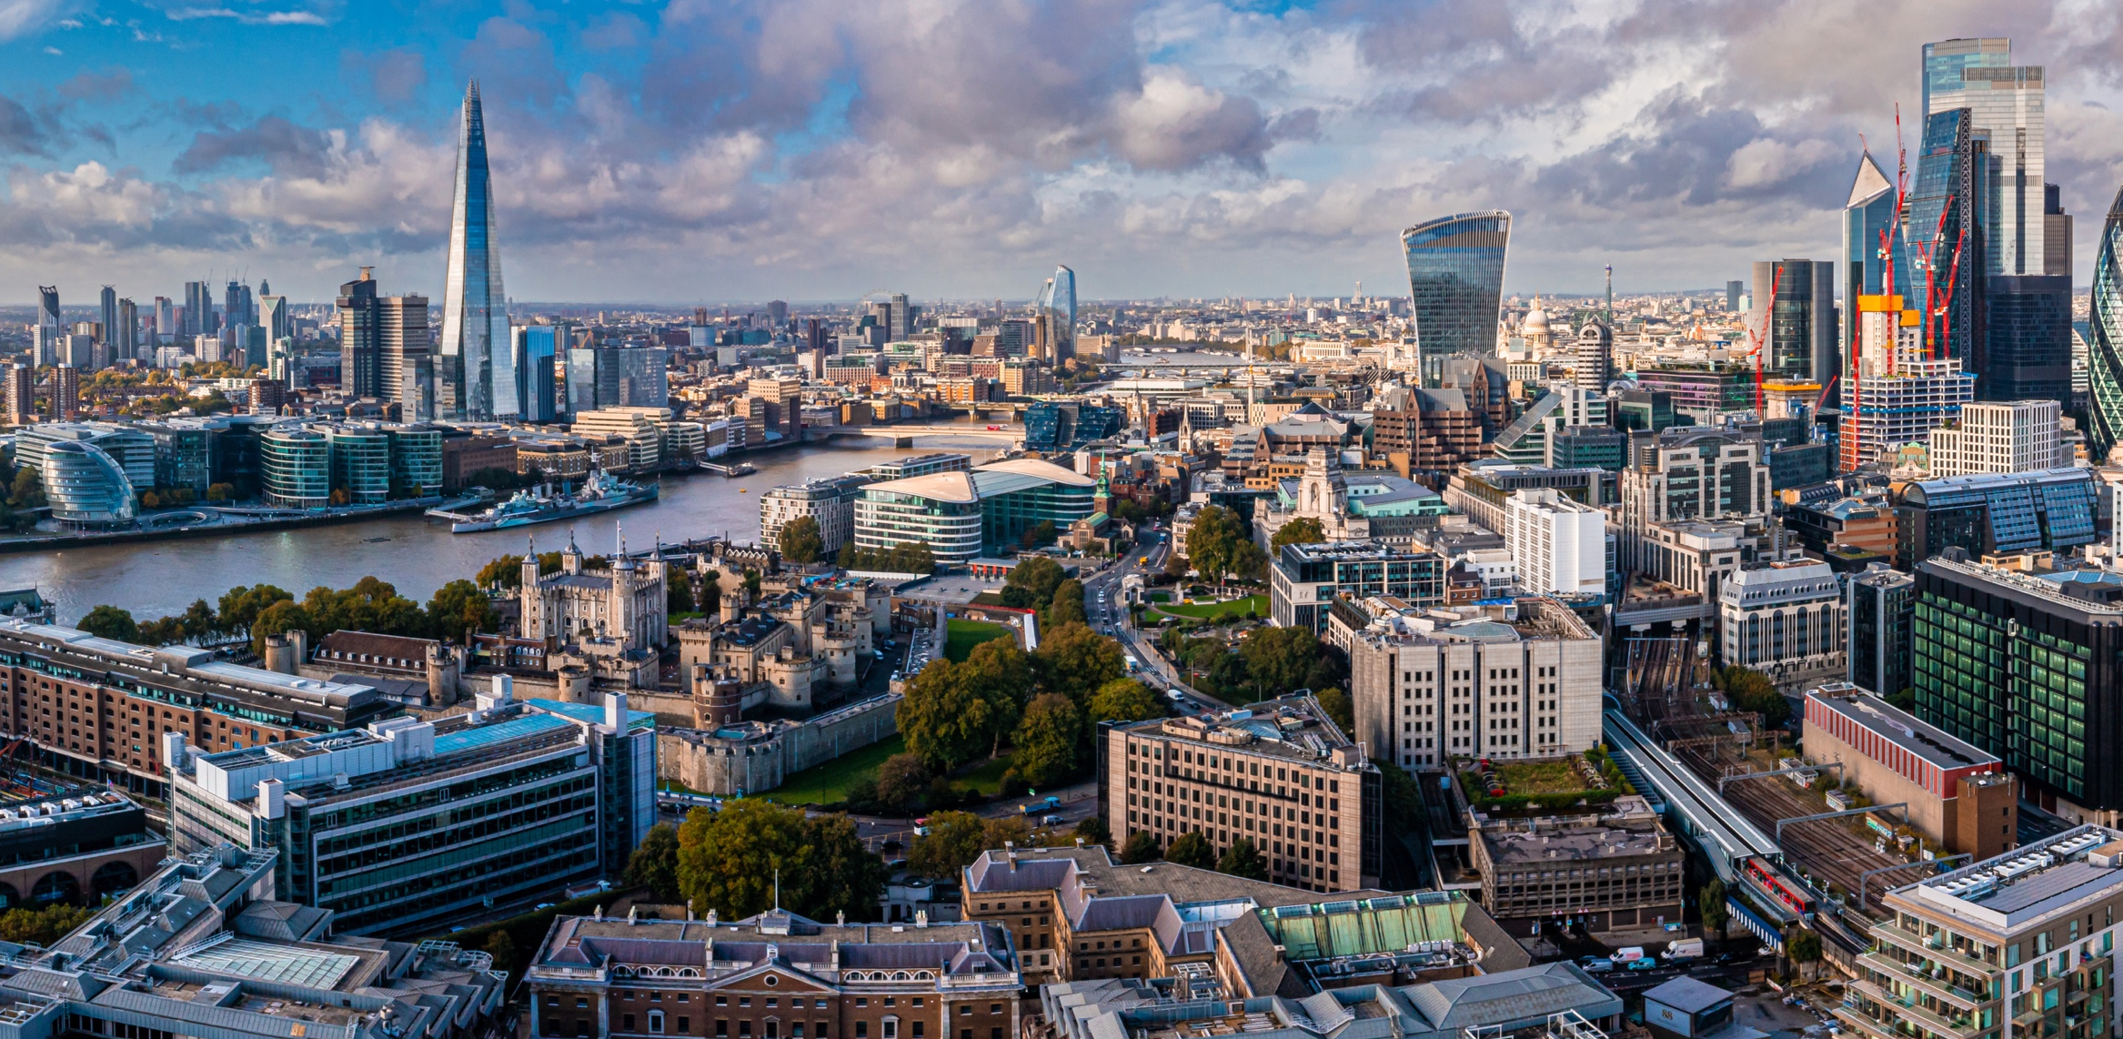
ROADSHOW SUPPORT
Take your message to carefully curated investors both in-person and virtually
Strategic Plan
Targeting
Schedule management
Follow up support
Curated investor outreach based on your strategic goals
We combine the 121 proprietary database with your top news readers, peer and sector analysis to create a country-by-country investor target list
Investor communications, detailed investor profiles and schedule management, working closely with the client
Schedule follow-up calls and help to maintain investor relationships

Slide 6

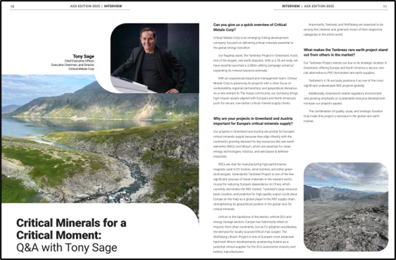
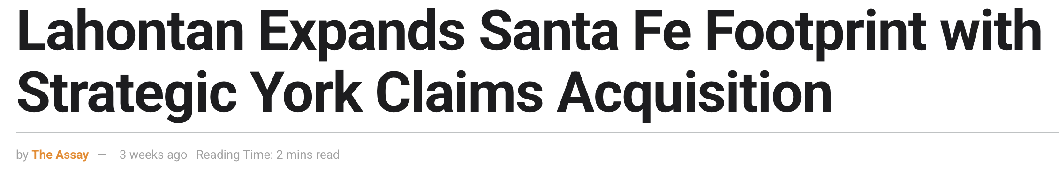
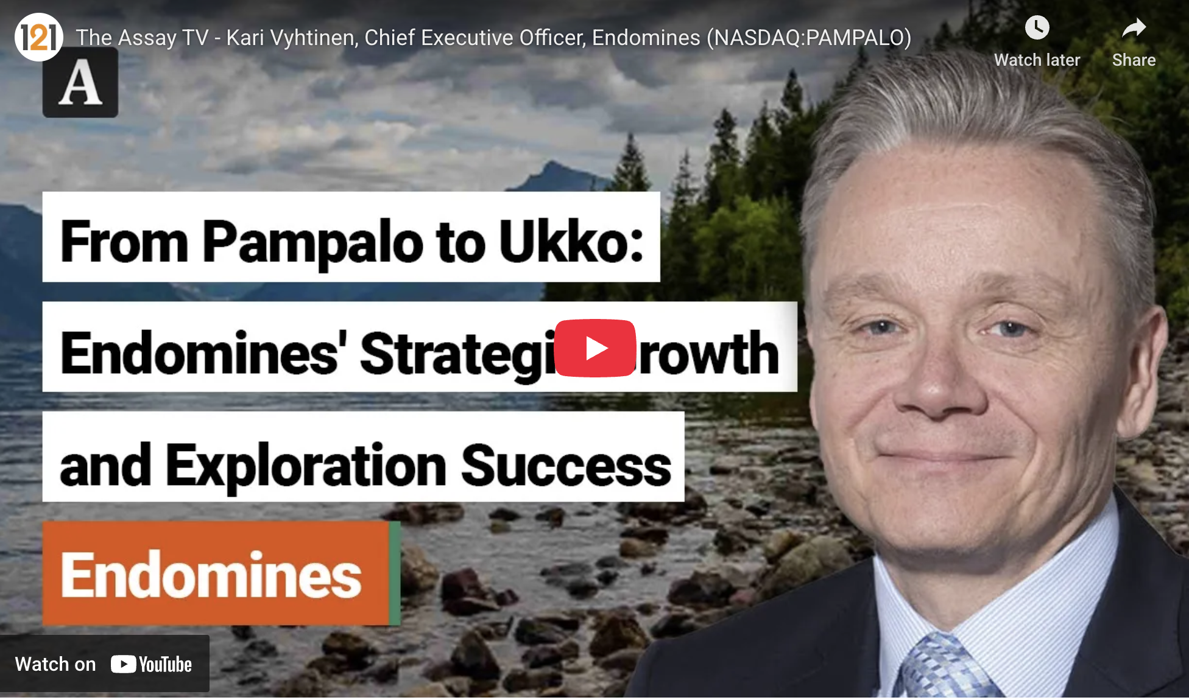
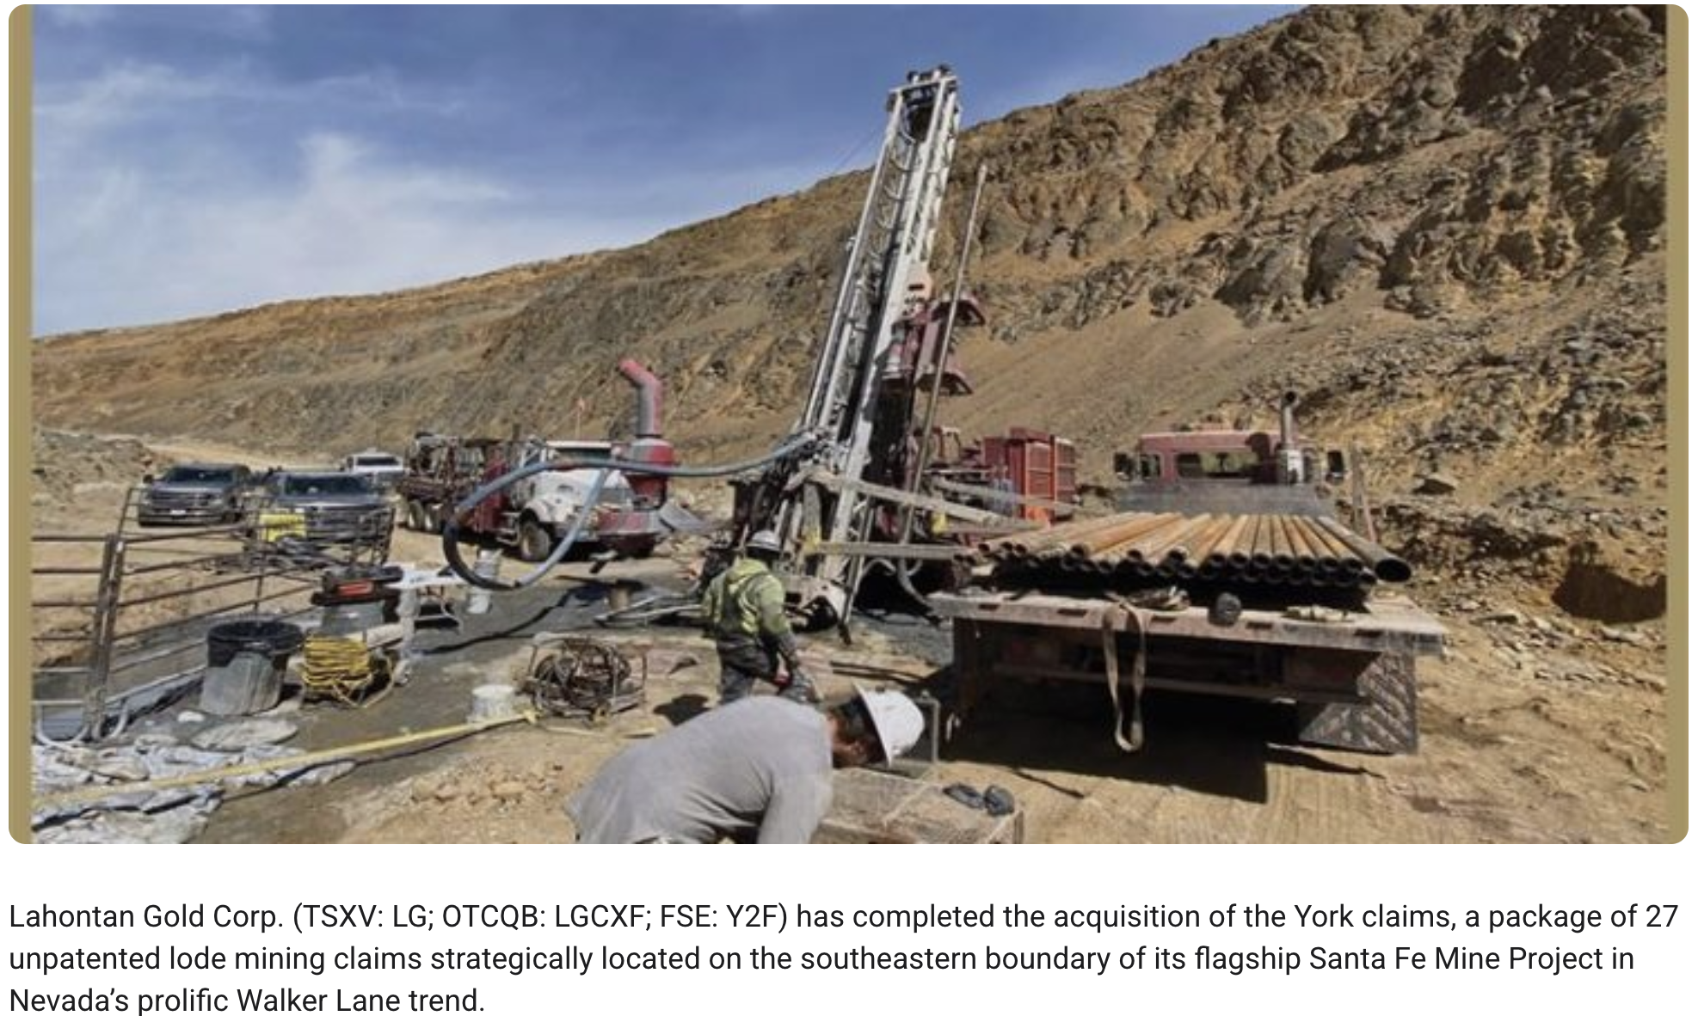
THE ASSAY PLATFORM
Amplify your story via The Assay, our always-on proprietary online platform, including news features, company profiles, editorials and CEO video interviews
Your important news, project updates and editorials distributed to our network of c. 17,000 global investors
The Assay magazine
4-page company editorial
The Assay news
write up
The Assay CEO
interview video

Slide 7
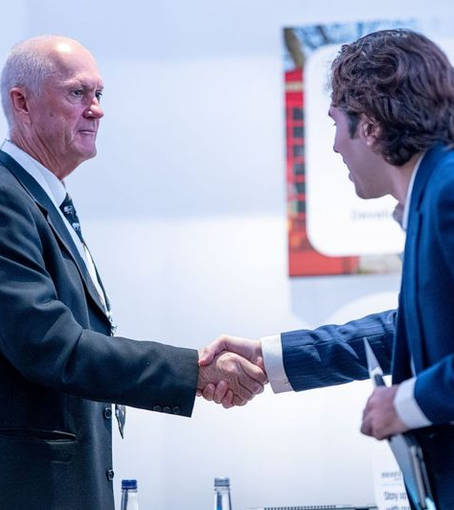
SUCCESS STORIES
“Elevate Uranium have been using 121 Investor Engagement for over 12 months now and we are very pleased with the outcomes. We’re getting specialised contact with uranium investors through the distribution network, and it is also taking organising meetings out of my hands. They've been organising my meetings at Cape Town, New York and London 121 Events and I’m having full books at all of them. Very happy with the outcome so far and quite enjoying attending meetings.”
Murray Hill
Managing Director & CEO
Elevate Uranium

Slide 8
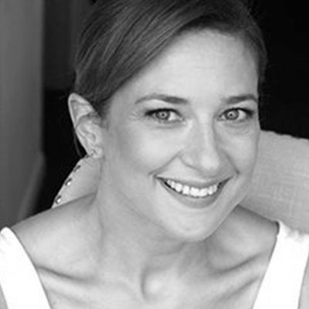
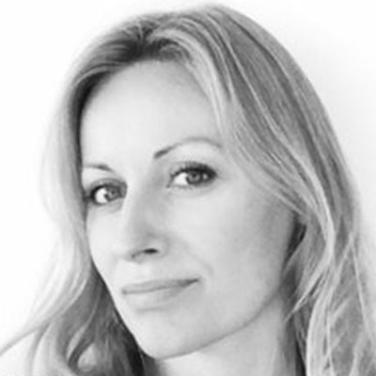
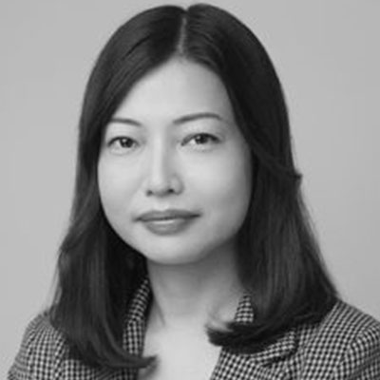
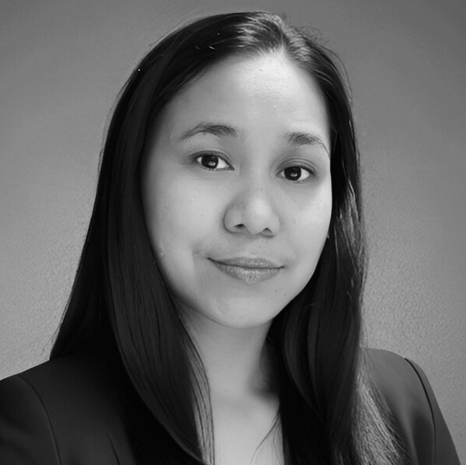
IE TEAM CONTACTS
The Assay news
write up
Jen Earle – Head of Engagement
London
Anna Michniewicz
London
Akina Tse
Hong Kong
Laarnie Villarosa
Hong Kong
Unlock year-round, tailored access to the industry’s most powerful global investor network with the 121 Investor Engagement Programme.
Get in touch | ieteam@121mininginvestment.com

