Slide 1
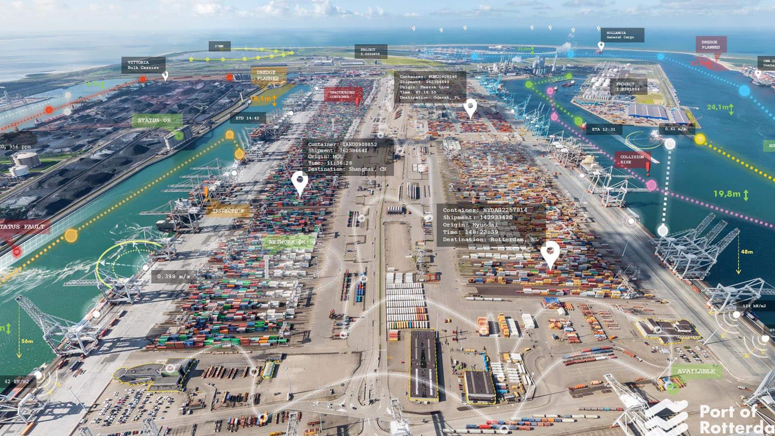
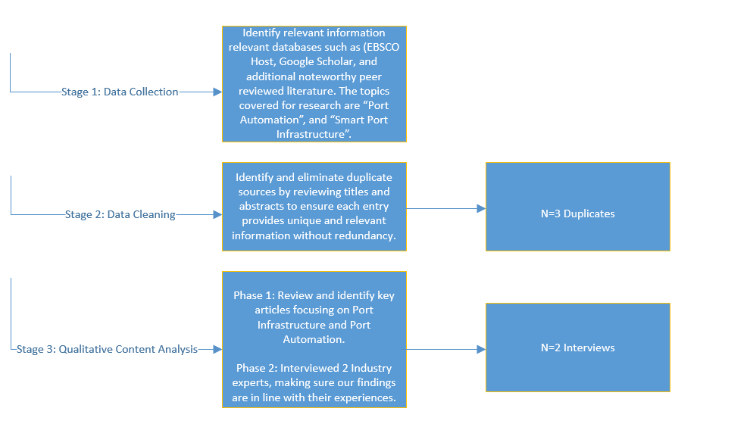
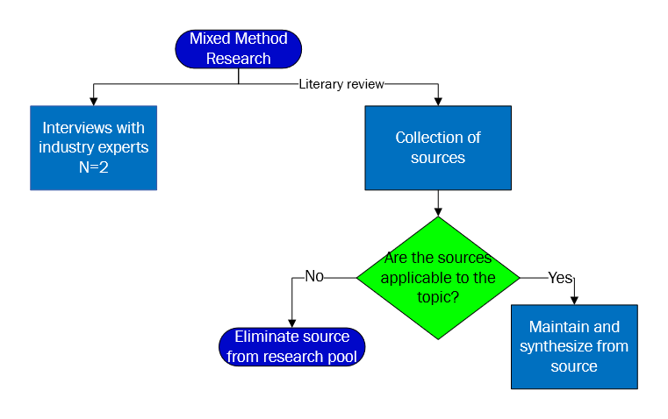
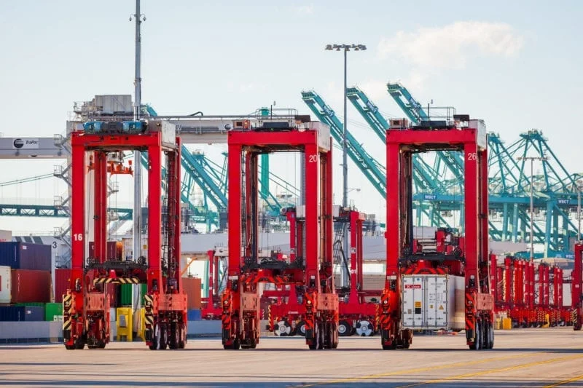
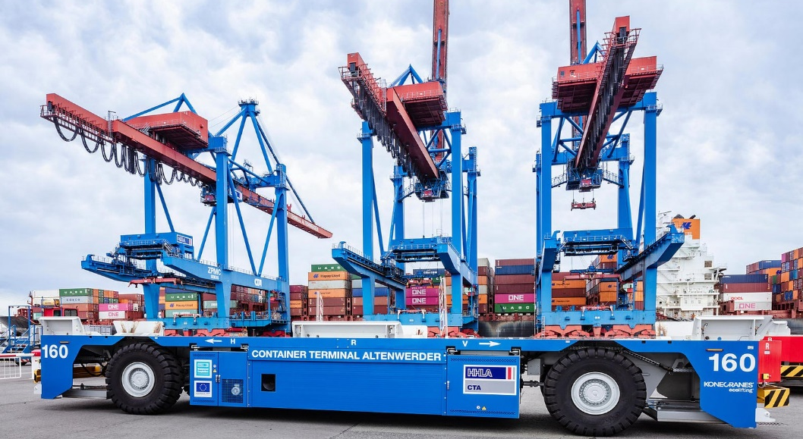
6
Methodology
Introduction
Introduction
Academic literature already points to the future development of fifth and sixth generations of ports with different published definitions. Port automation has been identified as a crucial element to the future of port infrastructure and a transition towards future generations of ports. European ports have provided an exemplary path toward the proliferation of automated ports. Ports such as the port of Rotterdam and the port of Hamburg are regarded to be highly technologically advanced and the transition towards automation.
Photograph 1: Digital twin of the Port of Rotterdam (The inside story of autonomous ships at Europe's largest port, 2024)
The research team faced several limitations such as limited time constraints, limited accessibility, and the inability to conduct interviews with a more robust number of industry advisors.
66
Benefits
Infrastructure
Automated Straddle Carriers:
Versatile, autonomous vehicles used in ports to transport, load, unload, and stack containers. Capable of moving in all directions, they efficiently navigate tight spaces, transferring containers between quay cranes, storage areas, and trucks. By automating these tasks, they improve port efficiency, reduce manual labor, and optimize fuel usage, contributing to both productivity and sustainability.
Photograph 2: Automated Straddle Carrier in the Port of Los Angeles (TraPac)
Operational Efficiency
Reduction of vessel dwell times and longer operational windows (24 hours, 7 days a week) allow for automation to maintain ports competitive. These measures also allow reductions in labor costs
Optimizing Efficiency Through Automation in Port Infrastructure
Data Analytics
Automation allows for efficient data collection allowing for predictive analysis. IoT-generated data allows for more efficient collection of port data such as ship and truck turnaround time. Data analytics has also allowed ports, such as the Port of Rotterdam, to collect information about the environment and disturbances. Better visibility also allows for better decision making
IoT | Sensors & Transponder Systems: Sensors in ports that enable real-time tracking of containers, vehicles, and equipment, providing operators with precise location data. When paired with data analytics, these technologies optimize container movement and improve operational efficiency by reducing delays and human error. This integration enhances safety, streamlines decision-making, and lowers overall costs in port operations.
Photograph 3: Transponders found in the Port of Rotterdam (Discovery UK, 2020)
Reduction of Human Error
Port automation and smart port technologies offer significant benefits in reducing human error by streamlining operations and enhancing accuracy. Automated systems minimize reliance on manual tasks, which are often prone to mistakes, leading to improved cargo handling, tracking, and processing efficiency. Additionally, real-time data analytics and predictive algorithms enable better decision-making, ultimately increasing safety and operational reliability within the port environment.
Simulations have shown that adding automation to existing ports can reduce the ship turnaround time and TEU capacity by (Jobran & Kara, 2022).
18%
Faster ship turnaround time
Lawson Lawson, Daniel Seco,
Armando Toledo, Horyrah Uddin
Faculty Advisor:
Professor Margaret Kidd
University of Houston
Industry Advisor: Dennis Devlin – Maersk
Luis Mejia - Kiewit
Lars Martin Greiner - Red Sea Gateway Terminal
Automated Guided Vehicles:
Self-operating vehicles used in container terminals to transport containers from quay cranes to storage areas, improving efficiency and safety by following pre-programmed routes. These vehicles work seamlessly with other automated equipment to streamline container handling and reduce labor costs.
27%
Increment in port storage capacity
Photograph 4: AGV found in the Port of Hamburg (Automated Guided Vehicles)
Greater productivity was achieved using automated straddle carriers (ASCs) in simulation utilizing a systematic model (Tsaples et al, 2021).
Greater berth productivity [TEUs/meter/timestep] found when implementing ASCs as opposed to manned vehicles
6
6
Challenges
High Cost of Initial Investment
Port automation requires significant upfront investment in advanced technologies, equipment, and infrastructure upgrades, including automated cranes, self-driving vehicles, and digital systems. U.S. ports face challenges like strong labor union resistance, complex regulatory environments, and fragmented public-private ownership structures that complicate decision-making and funding. Integrating new technologies with existing systems and ensuring cybersecurity add further costs and complexity. Despite these hurdles, automation is critical for U.S. ports to remain competitive with more advanced global ports in China, Singapore, and Europe.
Conclusion
References
References
Unionization & Regulation
There is contention against automation through port labor unionization. Dock workers face the flexibility of the industry and the peaks and troughs of flow at the ports. This has pushed port labor towards “high rates of unionization” and often strong resistance to changes in labor practices (Bottalico 2022, Pg. 32). Ports differ in their organization of labor and unions, leading to different needs faced by their labor force and, consequently, different responses to technological changes that may affect them (Pg. 35).
The integration of automation and artificial intelligence (AI) in port infrastructure is revolutionizing global logistics, enabling unprecedented levels of efficiency, cost savings, and safety. European ports, such as Rotterdam and Hamburg, have taken the lead in this technological transformation, implementing advanced systems like automated cranes, self-driving vehicles, and AI-driven predictive maintenance. Some advantages observed after the application of port automation have been streamlined operations, reduced environmental impact, and enhanced cargo handling, and have helped these ports be at the forefront of logistics innovation. Similarly, ports in Asia, including those in Singapore and Shanghai, have embraced automation and AI technologies, adopting systems such as automated guided vehicles (AGVs) and AI-powered scheduling. These advancements have led to significant improvements in handling capacity and operational efficiency, allowing both European and Asian ports to meet the growing demands of global trade effectively. In contrast, U.S. ports have been slower to adopt full-scale automation, facing challenges such as complex regulatory environments, labor union opposition, and substantial investment requirements. While some U.S. ports, like Los Angeles and Long Beach, have made progress with automated gate systems and partial container handling automation, they still lag their European and Asian counterparts. This disparity in adoption rates underscores the need for a more collaborative approach in the United States, involving increased government support, comprehensive stakeholder engagement, and strategic investments in port infrastructure. To remain competitive in international trade, U.S. ports must overcome these challenges through cooperation between government entities, industry stakeholders, and labor unions.

