Slide 1
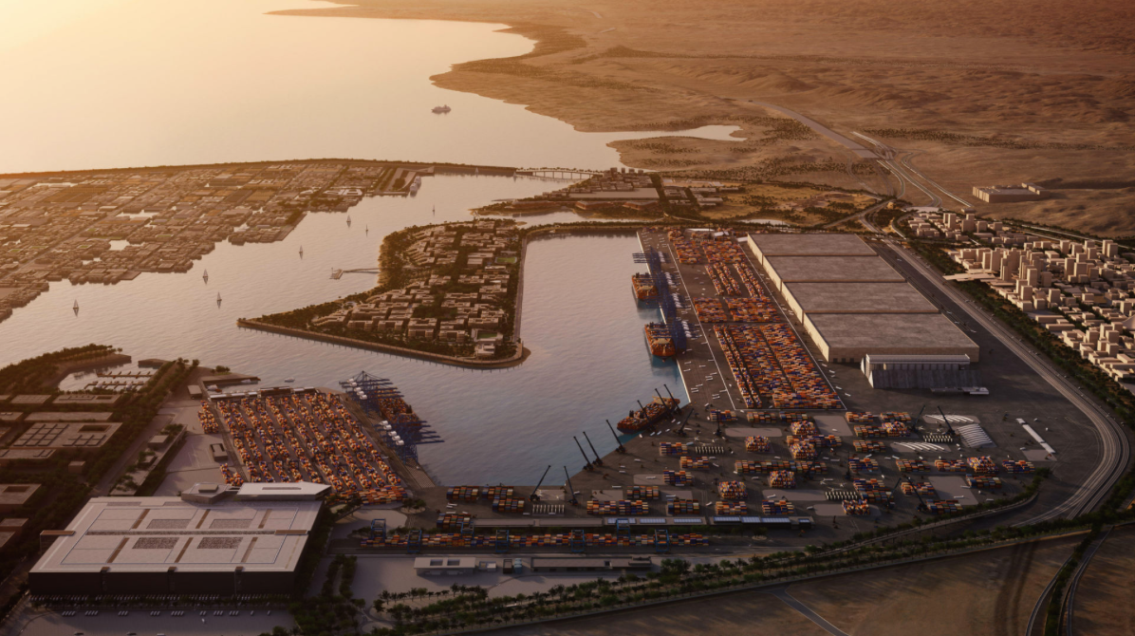
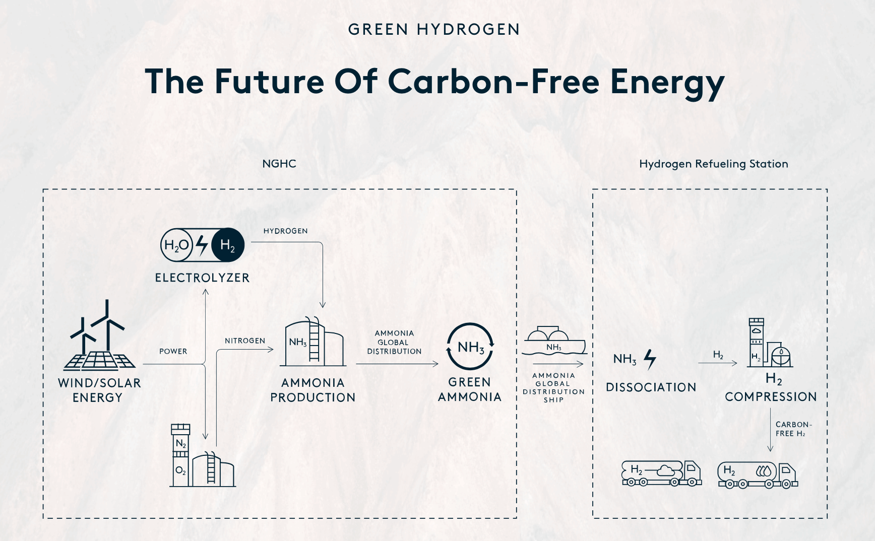
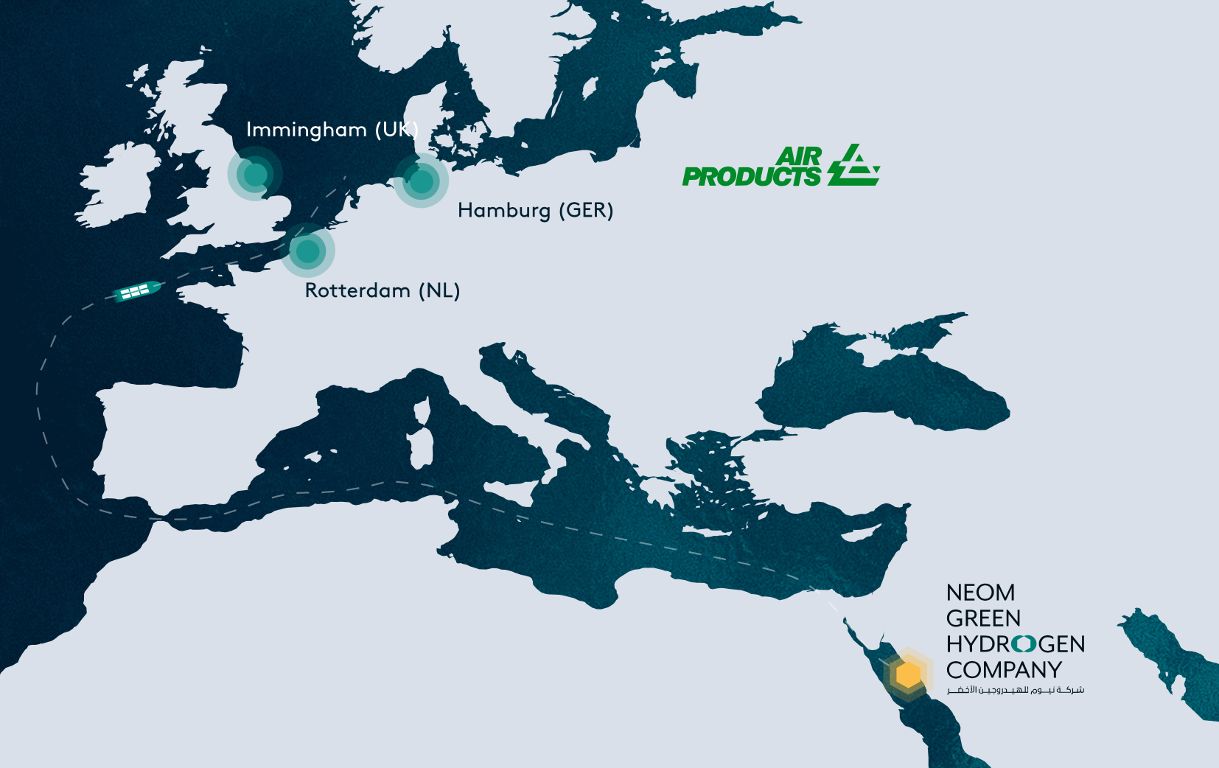
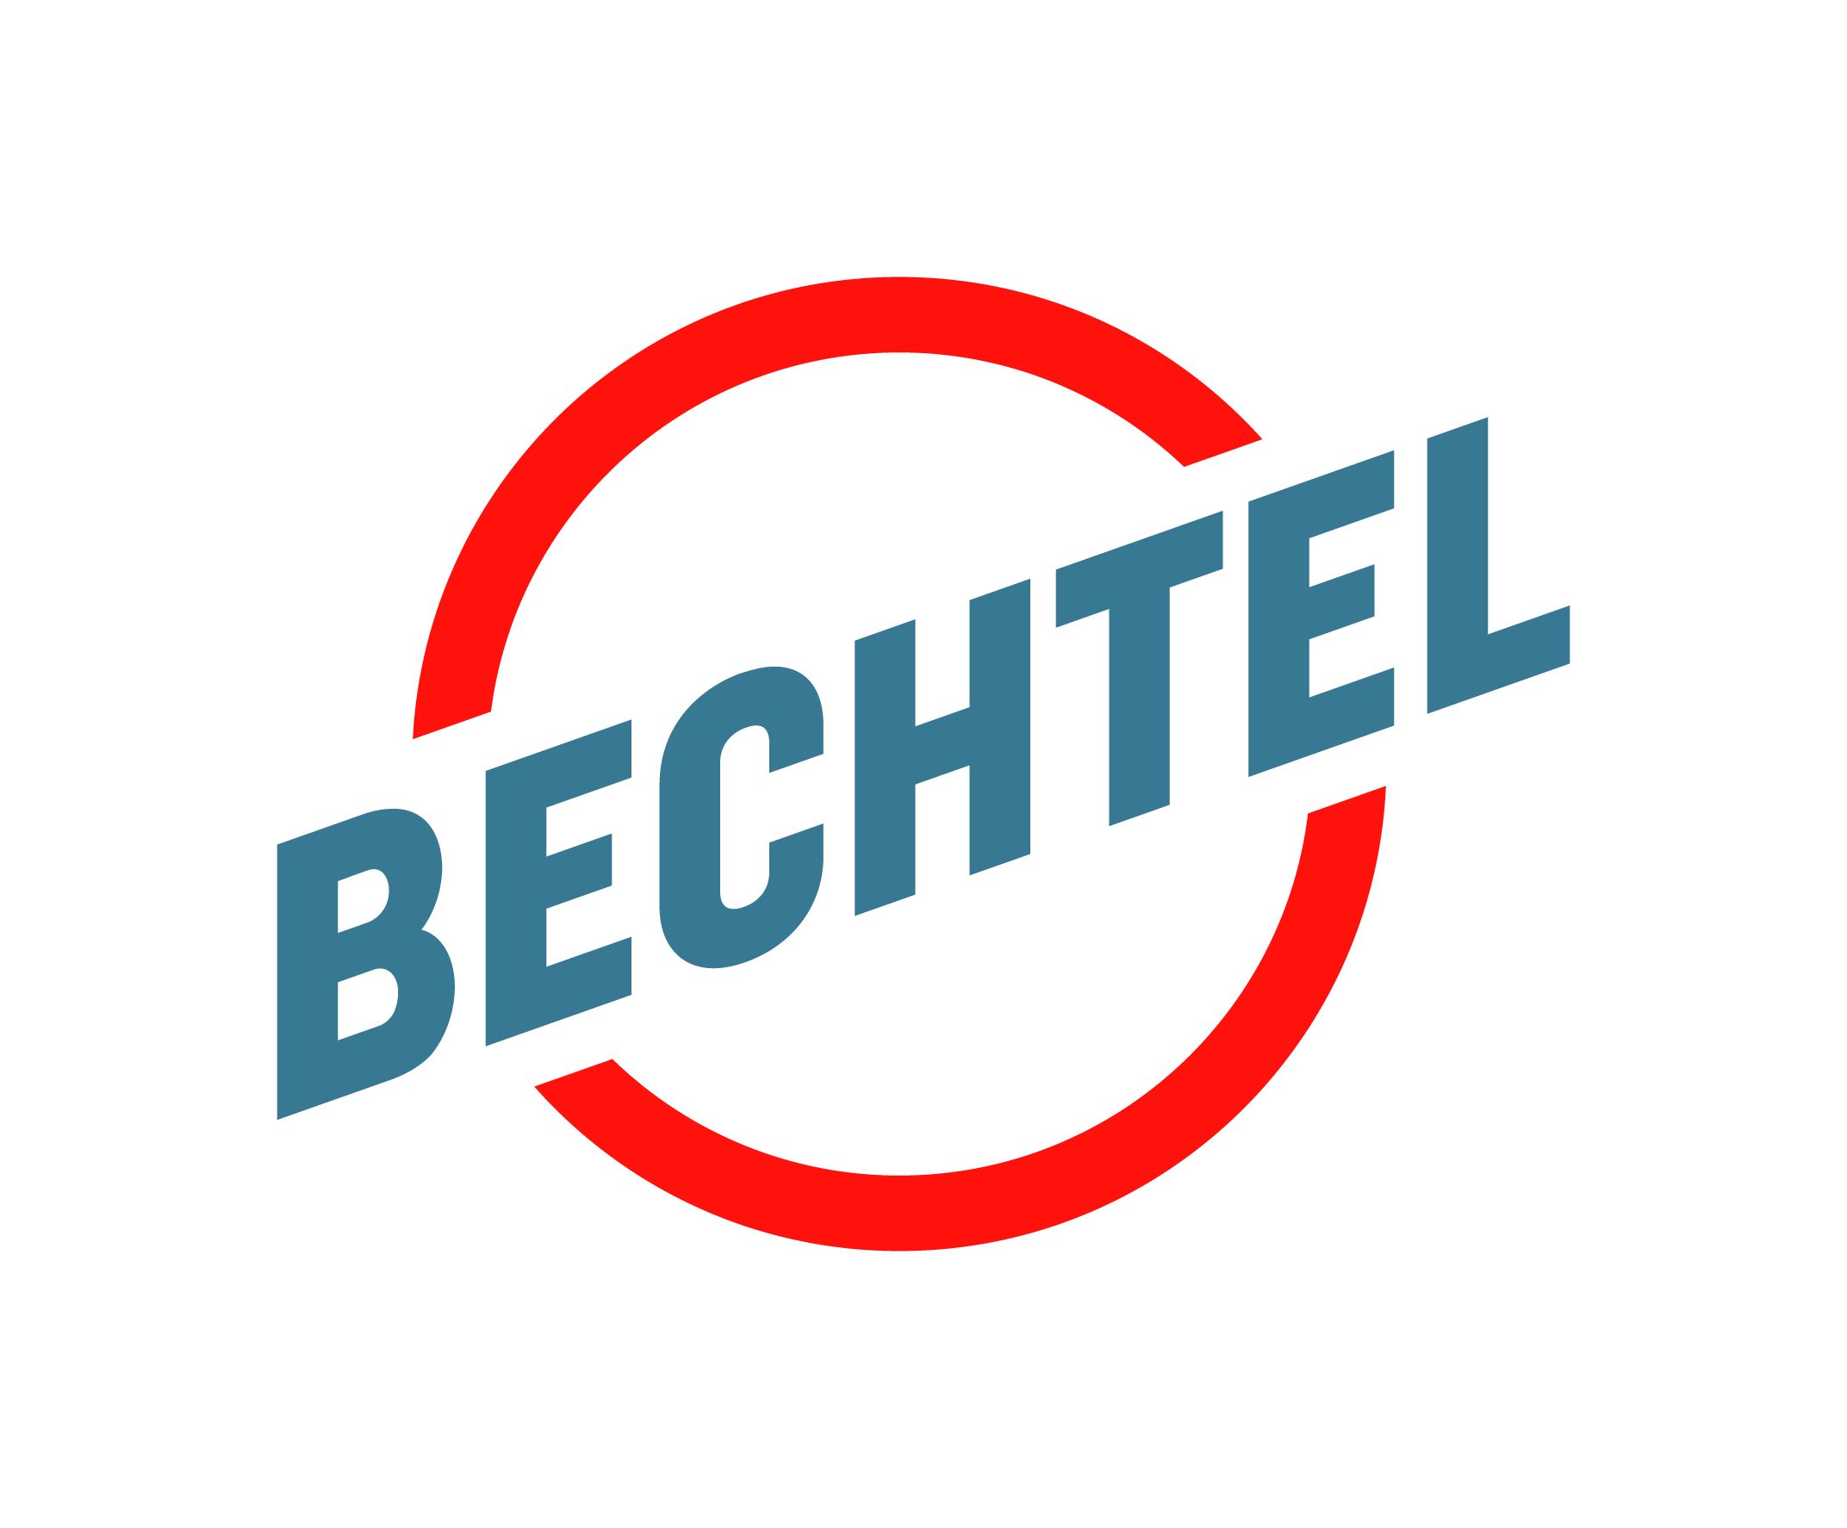
Abstract The NEOM Green Hydrogen Company is developing the world’s largest green hydrogen plant, set to produce green ammonia by 2026, powered entirely by renewable wind and solar energy. This study focuses on the engineering requirements and environmental impact of using hydrogen as a sustainable energy source to supply the NEOM city and port, which aims to be a next-generation logistics hub. By examining the feasibility of hydrogen power in this context, the study contributes to advancing sustainable energy solutions, reducing carbon emissions, and achieving NEOM's goal of becoming a renewable-energy-only city providing a model for global energy transition efforts. NEOM Green Hydrogen Plant The NEOM Green Hydrogen Company is constructing the world’s largest green hydrogen plant, harnessing renewable wind and solar energy to produce green ammonia. This USD 8.4 billion facility is central to NEOM's goal of becoming a zero-emission city. Expected to be operational by 2026, the plant will play a vital role in powering NEOM, using green hydrogen for energy storage and grid stabilization. "Green hydrogen is made through a process called electrolysis... In electrolysis, you can use electricity to split water into two components" (NEOM Green Hydrogen Company, 2024). This process also positions NEOM as a key hydrogen exporter, advancing global clean energy efforts.
NEOM City NEOM is a groundbreaking urban development in Saudi Arabia, envisioned as a model for sustainability and technological advancement. Situated in the northwestern region of the country, NEOM will be powered entirely by renewable energy and designed to minimize environmental impact while fostering innovation. It aims to be a hub for advanced industries, clean energy, and sustainable living, positioning itself as a global leader in environmental stewardship and urban development.
Application NEOM Green Hydrogen Company, a joint venture between ACWA Power, Air Products, and NEOM, is building the world’s largest green hydrogen plant, powered by renewable wind and solar energy. Set to produce green ammonia by 2026, "The NEOM Green Hydrogen Project in Saudi Arabia, Middle East is being built at a cost of USD 8.4 billion. It received funding from 23 local, regional, and international banks and financial institutions" (Blackridge Research, 2024). The plant will support NEOM’s vision of becoming a renewable-energy-only city.
This study examines the engineering and environmental aspects of using hydrogen to power NEOM's city and port, focusing on the integration of electrolyzers, storage systems, and grid stability. NEOM's renewable energy model suggests a potential annual output of 60 TWh, with hydrogen crucial for energy storage and grid stabilization. By harnessing additional wind and solar capacity, NEOM aims to become both a hydrogen production hub and a zero-emission logistics center.
Integrating Green Hydrogen NEOM Port will play a central role in NEOM's renewable energy strategy by integrating green hydrogen into its logistical operation, significantly supporting the city’s zero-emission goals. Utilizing hydrogen for power will reduce the port’s carbon footprint and position it as a major hub for global hydrogen exports. The technical and environmental feasibility of hydrogen powered NEOM is demonstrated using advanced electrolyzers and largescale storage solutions, which are crucial for stabilizing the grid and meeting energy demands. Hydrogen will help efficiently utilize excess renewable energy, reducing reliance on fossil fuels and contributing to NEOM’s goal of becoming a zero-emission city. Overall, NEOM Port’s integration of green hydrogen underscores its importance in advancing sustainable logistics and reinforces NEOM’s leadership in the global energy transition.
NEOM Port NEOM Port will be pivotal in the city's renewable energy strategy, integrating green hydrogen into its logistics and positioning itself as a global hub for hydrogen exports. Air Products will power the port’s operations using advanced electrolyzers and large-scale storage systems to efficiently utilize surplus renewable energy and reduce fossil fuel dependence. This collaboration supports NEOM's zero-emission goals and solidifies its leadership in sustainable logistics and the global hydrogen export market.
Conclusion NEOM’s ambitious project to integrate green hydrogen into its city and port operations represents a significant step toward achieving a sustainable and zero-emission future. The technical feasibility of using hydrogen, supported by advanced electrolyzers and large-scale storage solutions, aligns with NEOM’s goals of reducing carbon emissions and maximizing the use of renewable energy. NEOM Port’s role as a hydrogen logistics hub will not only support the city’s energy needs but also enhance its position as a global leader in hydrogen exports. This approach exemplifies a forward-thinking model for urban and industrial sustainability, setting a benchmark for global energy transition efforts and demonstrating the transformative potential of hydrogen in achieving a cleaner, more sustainable energy landscape.
Harnessing Green Hydrogen: NEOM Port’s Path to a Zero-Carbon Future
Figure 1: NEOM City Port. (Source: neom.com)
Seddiq Sbaihat, Kium Libock, Chicuong Nguyen, and Joshua Arsola
Faculty Advisor: Beth Kennedy
University of Houston
Figure 2: Hydrogen Processing. (Source: nghc.com)
Figure 1: projected Hydrogen Export Destinations. (Source: nghc.com)
References:
Notes:
`

