Slide 1
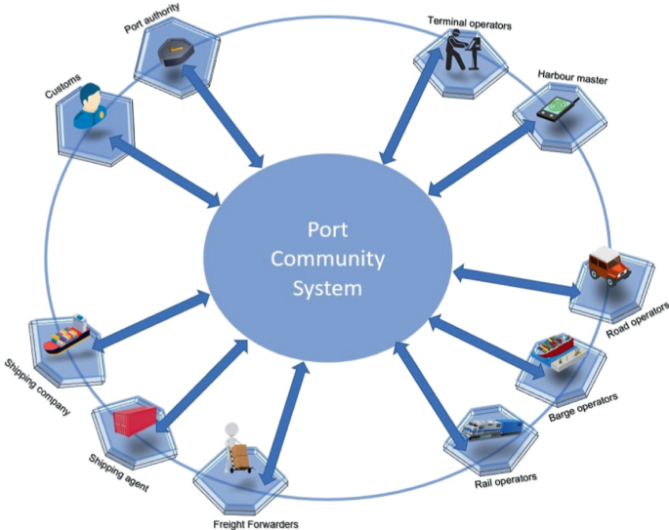
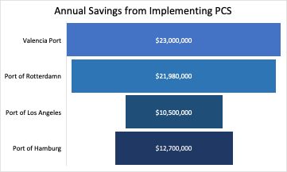
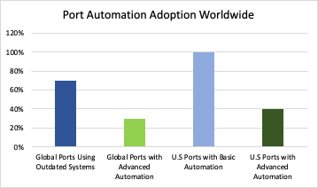
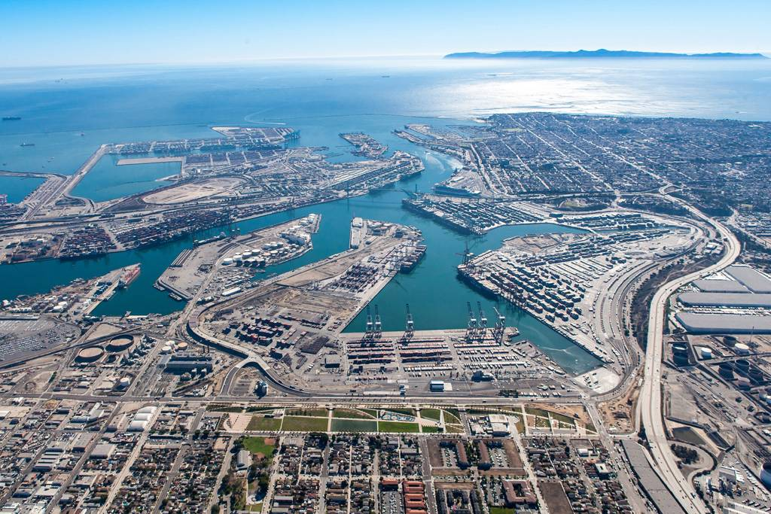
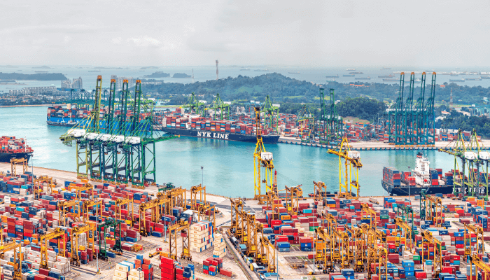
Abstract
Methodology
Results
Intermodal infrastructure plays a critical role in enhancing the efficiency and connectivity of global trade networks by integrating various modes of transportation, such as rail, road, and maritime systems. Ports are pivotal in this infrastructure, acting as crucial hubs for different transport modes.
Port Community System
The implementation of smart port technologies like port communication systems has aided these ports achieve significant reduction of cargo handling times.
A Port Community System (PCS) is an open electronic network which facilitates real-time data exchange and coordination among different members of the information and communication system.
20%
15%
30%
Valencia
Los Angeles
Hamburg
Effective intermodal connections reduce transit times, lower costs, and minimize environmental impacts by optimizing routes.
In addition to reduction of cargo handling times, multiple national ports have seen significant financial gains through the use of PCS.
Aiding in improving speed, communication, and operational transparency by optimizing efficiency and reducing bottlenecks. The benefits of a PCS are abundant and broad, they can be separated into two major categories: Internal Improvements and Community Accessibility.
Challenges
Infrastructure Bottlenecks: Outdated infrastructure cannot keep up with growing cargo volumes, leading to congestion and delays.
Poor Road and Rail Connectivity: Insufficient links to rail and road networks slow cargo transfers, increasing time and costs.
Fragmented Systems: Lack of real-time data sharing between stakeholders causes miscommunication and scheduling delays.
Customs and Regulatory Delays: Inefficient customs procedures extend delivery times and increase costs, especially without integrated systems.
Underinvestment in Technology: Many ports lack automation and smart systems, making it difficult to manage growing cargo volumes efficiently.
Internal Improvement
Valencia Port has saved $23 million annually since adopting PCS. Port of Rotterdam reported annual savings of $21.98 million. Port of Los Angeles and Port of Hamburg have also experienced substantial financial benefits, with savings of $10.5 million and $12.7 million per year, respectively.
Using an electronic network like PCS allows instant access and transfer of accurate data across all members. This decreases the rate of data errors to near zero, along with saving costs by reducing internal labor and time spent collecting, storing, accessing, and transferring data.
Conclusion
In conclusion, an intermodal infrastructure is vital for the optimization of global trade. Though many ports have issues with connectivity challenges affecting efficiency. With the introduction of smart port technologies, such as the Port Community System (PCS), many of these issues would be effectively solved. By enabling real-time data exchange and improving communication, PCS reduces errors and increase financial gains. Moreover, it enhances accessibility for all stakeholders, streamlining operations.
Community Accessibility
From Sea to Rail: Implementing Smart Technology into Intermodal Ports
Port Community Systems also come with the benefit of greatly increased community accessibility, allowing members to access real-time data regarding services, along with improving communication between parties. Stakeholders can also stay better informed and access relevant data through PCS.
Karyn Phankhao, Dylan Seecharan, Daniel Vickers, Samuel Orihuela
Faculty Advisor: Margaret Kidd
University of Houston
Intermodal Ports
QR
Port of Los Angeles
Port of Singapore
Port of Hamburg
Located in the US, 7 major container terminals and 6 intermodal rail yards with direct access to the Alameda Corridor
Located in Asia, this port is the busiest container transshipment hub and largest publicly owned
Located in Europe, it is the third largest with more than 1300 freight trains operating a week

