Slide 1
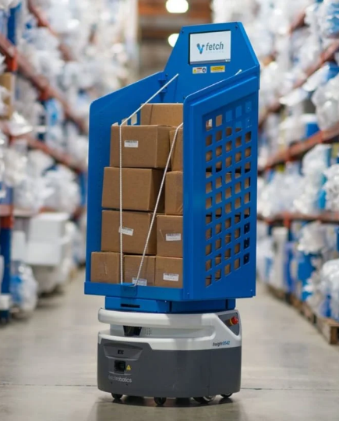
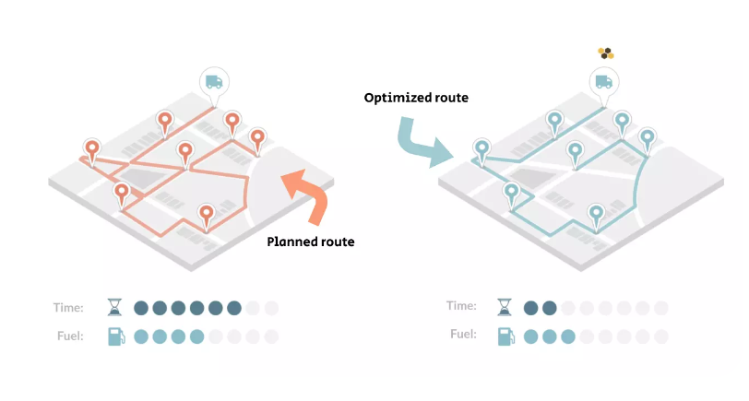
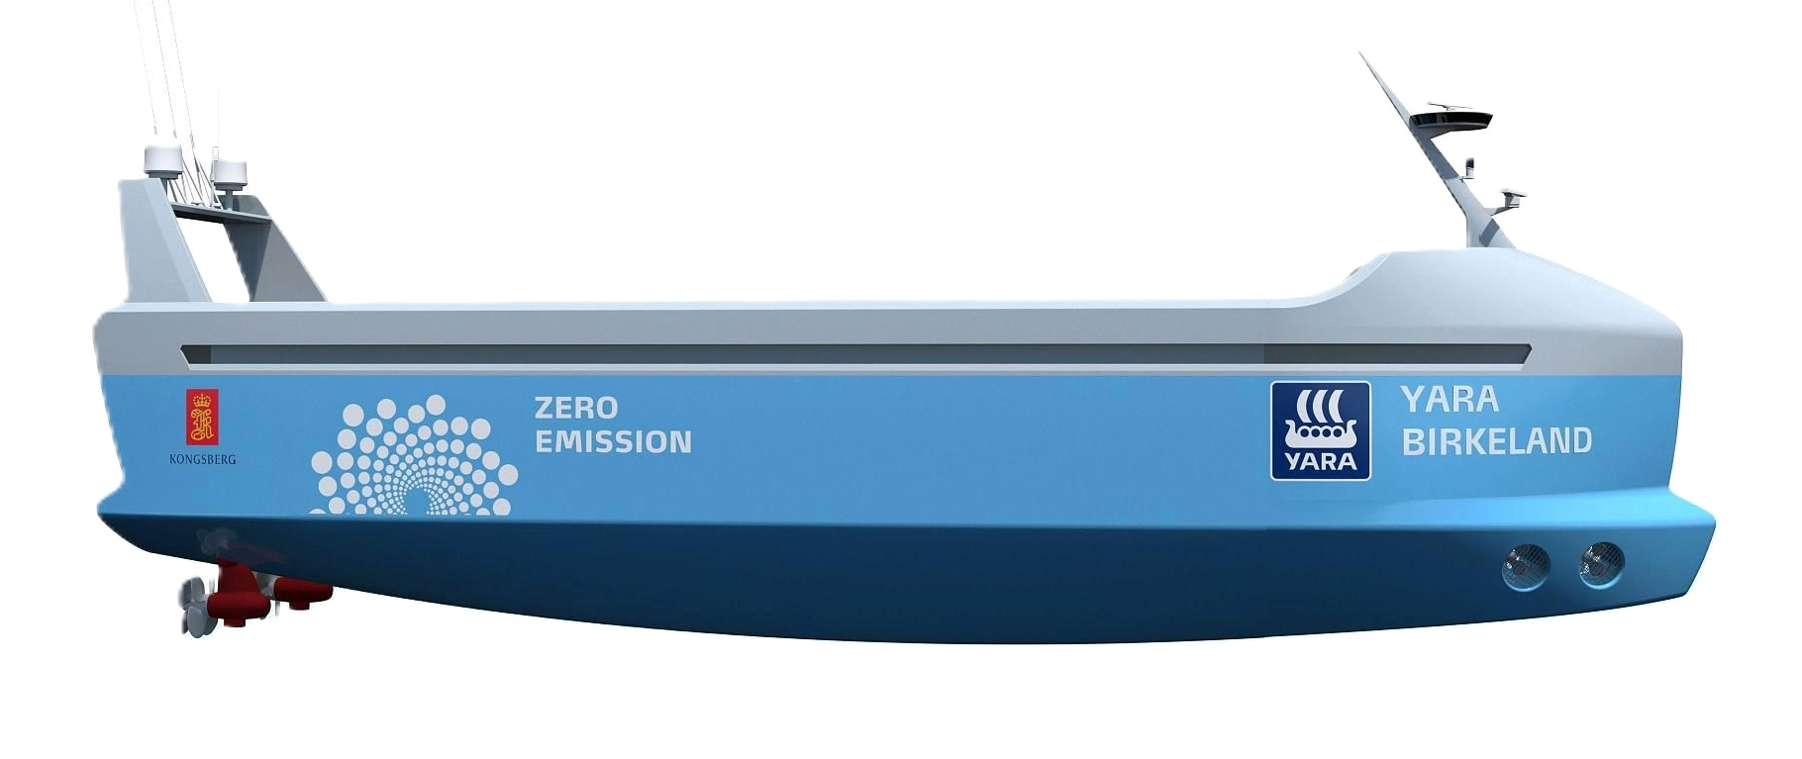
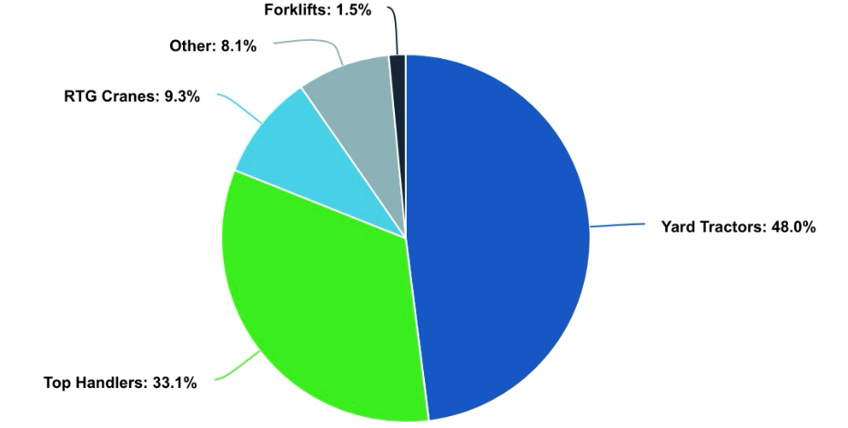
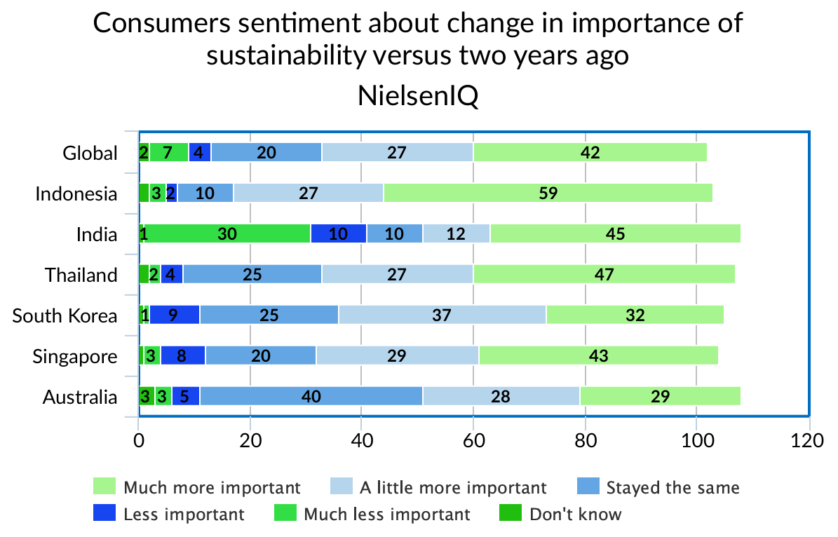
Abstract
Methodology
1
2
Methodology
As e-commerce continues to grow, consumer expectations for environmental sustainability are driving innovation in supply chain technologies. This trend is enhancing visibility, circularity, and data-driven resource optimization while increasing the adoption of technologies like electric propulsion for ships and IoT vehicle systems to meet sustainability objectives. With the e-commerce market worth $980.88 billion in 2024 and a projected growth rate of 6.36% through 2029 (IBISWorld, 2024), the e-commerce boom raises consumer concerns about environmental impacts like environmental degradation from increased demand for shipping, high emissions in last-mile delivery, more efficient post systems due to the increased flow of commerce, and more efficient use of warehouse resources. Together we will explore how the demand for sustainable e-commerce is driving technological advancements across the supply chain, from ports to consumer doorsteps, aligning with consumer demands for green solutions.
This research poster employed a qualitative approach to investigate how consumer demand for sustainable e-commerce has driven innovation in supply chain technology. The study analyzed recent trends, peer-reviewed journals, case studies, and industry practices over the past five years to understand the relationship between sustainability initiatives and technological advancements in supply chains. Relevant sources are found through academic databases, trade publications, and consumer survey data. Additionally, the study incorporated real-world industry case studies that showcased how leading companies in supply chain sectors have integrated sustainable practices. These case studies provided concrete examples of how consumer preferences for eco-friendly products have shaped supply chain operations, leading to the adoption of new technologies such as picking robots for cold ironing, route optimization for efficient logistics, and electric propulsion. ​
Port
Warehouse
Last-Mile Delivery
Ship
Port
3
Ships
4
5
Warehouse
6
6
In e-commerce and supply chains, sustainability has become a pivotal focus in transportation, primarily in the maritime industry, where a significant amount of e-commerce shipping occurs across oceans. The International Maritime Organization (IMO) has found that the highest ship emissions come from ship propulsion systems that use diesel engines. The IMO recently published a report revealing that ships using propulsion systems powered by diesel engines contributed 2.89% of total global anthropogenic emissions in 2018 (8). It is estimated that the percentage can drastically increase to 18% by 2050 should no decisions be made to stunt this trend.
E-commerce sales are projected to reach $36 billion in 2026 (19), with the increased reliance on ocean shipping as a cost-effective transportation method, port traffic is expected to rise. With higher volume of ships, alternative port power sources are pivotal. Onshore power allows ships to shut off their auxiliary engines while berthed when connected to a local grid. Although it is an emerging technology, “shore power has been successfully used by the U.S. Navy for decades and is included in the Navy’s Incentivized Shipboard Energy Conservation program” (11). About 67% of a vessel’s emissions are estimated to be produced by berthing activities (4). When connected, ships can:
Picking Robots are revolutionizing the process of selecting and retrieving items. Autonomous mobile robots (AMRs) have many sensors, including LiDAR and ultrasonic. With the integration of AI through machine learning algorithms and Reinforcement Learning (RL), AMRs can adapt to changes and improve productivity (29).
Globally, “carbon emissions due to e-commerce logistics are forecast to hit around 25 million CO2 metric tons by 2030” (6) due to increased consumer demand. However, consumers are still pressuring e-commerce retailers to utilize greener last-mile delivery methods. Companies are closing the gap by deploying route optimization in last-mile delivery. Optimized routing services can “reduce the fuel consumption of road transport by 12–33%”. (13) This reduction is due in part by:
Consumer Demand & Behavior: Fueling Sustainable Technology in
E – Commerce in
Supply Chains
Orders being routed through the most efficient path, reducing delays caused by centralized bottlenecks
Fleet management systems “collecting vehicle data to plan shorter travel distances between the supply point and the consumer” (32)
Courtesy of Barcoding.com, 2024
To aid in reducing emissions from ships, a new integration with ship propulsion systems has been created. Though new, using electric propulsion in the maritime industry can significantly reduce the environmental impact of transportation by curbing:
Reduce carbon emissions
Reduce noise pollution
Improve air quality
Comply with environmental regulations
Computer Vision allows AMRs to recognize and track products and update inventory levels with the integration of cloud computing. RL into AMRs allows the robot to optimize its path to navigate the warehouse floor efficiently. RL optimizes the decision-making process for AMRs through a reward structure that typically values efficiency, energy conservation, and minimal operational disruptions (3).
Carbon Emissions
CO2, NOX, SOX
Environmental Degradation
Reduced biological diversity, low general heath for environments, acidification
Photochemical Ozone
Brown haze/ground level smog
According to a study by McKinsey & Company, According to a study by McKinsey & Company, experts anticipate a 50% increase in robot shipments and a 10% growth in warehouse automation annually through 2030 (7). Beyond cost savings, picking robots contributes to sustainability goals through their energy-efficient design, which:
Eutrophication
Excessive plant growth, lack of oxygen near water bodies
Unlike traditional internal combustion engines, electric propulsion systems are far more energy-efficient, meaning less energy is required to move the same amount of cargo. This translates to a lower carbon footprint and a cleaner environment, crucial for sustainable e-commerce operations. The ability of electric ships to integrate with renewable energy sources further enhances their sustainability. These ships can be powered by wind, solar, or hydroelectric energy, aligning with global efforts toward renewable energy. Additionally, advances in battery storage technology enable these ships to store energy, even when renewable resources are unavailable, ensuring continuous operation (8). This supports sustainable supply chain operations by reducing reliance on fossil fuels and helps e-commerce companies meet the increasing demands for environmentally friendly products and ethical chain standards.
Courtesy of EESI, 2024
Top handlers are specialized equipment used to lift efficiently, stack, and transport containers at ports. Historically, top handlers are diesel-powered and contribute to emissions at maritime ports. The electric top handers "run on a one-megawatt battery designed to operate for up to 18 hours between charges" (37). In June of this year, 215 diesel top handlers were at the Port of Los Angeles, accounting for a third of all emissions from cargo-handling equipment. Replacing diesel top holders drives the Port of Los Angeles to zero emissions and can lead other ports in the United States in the same direction.
Optimizes power consumption
Reduces waste through precise operations
Supports space optimization within warehouses
Tech that aids in Route Optimization
(Sykes, 2022)
Due to their precision and efficiency, picking robots are also ideal for implementing circular economy practices (26). Warehouses are often large and energy-intensive, frequently integrate renewable energy sources like solar panels. These innovations help curb the carbon footprint of logistics operations by:
Intelligent Transportation Systems (ITS)/IoT Management Systems
Uses devices like GPS and traffic sensors to monitor real-time data.
Enables fleets to use dynamic routing to ensure vehicles take the most efficient path.
It has “been argued applying ITS systems in metropolitan environments could improve vehicle street throughput by 20–25%” (13), signaling an increase in efficiency.
Decreasing reliance on grid electricity
Leading to both cost savings and reduced emissions (12).
2022 Cargo-Handling Emissions at the Port of Los Angeles
Automative Telematics Systems
MC01, 2018
Collect data on vehicle behavior, driver behavior, and route efficiency
Information can be used to optimize delivery operations and reduce fuel consumption
Supports predictive maintenance, ensuring vehicles operate efficiently and sustainably
Zainab Naaz Ansari,
Elizabeth Davis,
Landry Hernando,
Sommer Kobashigawa,
Sameerah Mustafa
Courtesy of Canva, 2024
7
Consumer Behavior
8
Conclusion
A recent survey by PWC coming out of the U.K. found that consumers were willing to spend around "9.7% more on average for sustainably produced or sourced goods" (31) despite the increased inflationary pressures looming over the consumer.
The consumers’ motivation to purchase sustainably manufactured goods is revealed by research data indicating that they are ready to pay extra for such products and seek to minimize their environmental impact. The rising trend in internet searches on green products and the high consumers' expectations of companies' responses to environmental issues is a strategic opportunity. Firms can properly align their supply chain and logistics with sustainable practices. The idea of sustainability can be the ultimate solution for companies to satisfy consumers’ needs while achieving competitive advantage in the new emerging economy.
As e-commerce continues to grow so does the consumer demand for sustainability within the supply chain and logistics industry. We are listening to the consumer by developing innovative solutions that reduce waste and curb emissions throughout the chain. By analyzing recent trends, peer-reviewed journals, case studies, and other reliable sources, we have pooled viable solutions that our supply chain leaders are implementing to respond to this consumer demand for sustainability. We researched the deployment of ship propulsion systems to combat the environmental degradation of our planet, onshore power supplies that help improve air quality, autonomous mobile robots that optimize space consumption in warehouses, and route optimization technologies that curb emissions. These advancements improve efficiency in handling high order volumes that come with e-commerce and minimize their environmental impact.
In another recent survey by NielsonIQ, NIQ, a total of "73% of global consumers" (27) responded that they were looking to curb their "consumption behavior to reduce their impact on the environment." (27). For instance, in places such as Taiwan, sustainability initiatives are much more powerful. According to NIQ (27), 88% of the consumer respondents considered it either 'very' or 'extremely' important for firms to introduce programs to enhance the environment. This indicates that companies that offer sustainable innovations in these areas can have a competitive advantage within the market.
Faculty Advisor: Alfred Henson
University of Houston
Another analysis by the Economist Intelligence Unit discovered that, since 2019, "there has been a 71% rise in online searches for sustainable goods globally" (23). This is a promising indicator of how supply chain and logistics should move forward to capture a larger market share. The data consistently show that consumers want companies to mirror their core values and priorities, including their moral and ethical efforts, to create a more sustainable future.
Industry Advisor: Andrea Paris (ExxonMobil)
References
Connect with us on LinkedIn
(NielsenIQ, 2019)

