Slide 1





Student Research Poster Competition
Recommendations for Students
The “Dos” and “Don’ts”
Event Chaired by:
Cassia Bomer Galvao, Associate Professor, Texas A&M University
Margaret Kidd, Dept. Chair, Logistics & Supply Chain Management San Jacinto College
Ivy Jenkins, Professor, Logistics & Supply Chain Management San Jacinto College

Slide 2


It is our pleasure to present to you the 2026 BreakBulk Americas Student Research Poster Competition, one of the highlights of our Education Day during this year’s edition of BreakBulk Americas taking place on Wednesday Sep 23rd 2026.
In this slide deck, you will find the main recommendations for a successful submission of your research poster and resources to help you excel at this competition.
Registration deadline is Thursday, September 3, 2026
Poster submission deadline Thursday, September 10, 2026
Important: Only registered teams will be eligible to submit a poster
Please feel free to reach out in case of additional questions.
Check out the Education Day Agenda here:
https://americas.breakbulk.com/agendas/education-day

Slide 3
Your Poster Submission – Step by Step
Step #1 Understand the Competition Details: The competition invites undergraduate and postgraduate students from Texas universities to present innovative research on topics such as global capital projects, sustainability & energy transition, and port infrastructure. (hint: careful read the instructions about Expectations, Advisors and Evaluation Criteria at https://americas.breakbulk.com/page/student-research-poster-competition)
Step #2: Select a Relevant Topic: choose a research topic aligned with the competition themes (hint: you can view last years winners in order to get inspired and refresh your own ideas https://americas.breakbulk.com/page/student-poster-competition-entries )
Step #3: Conduct Thorough Research: Gather data through literature reviews, case studies, interviews, or policy analysis. Ensure your research is comprehensive and relevant to the chosen topic.
Step #4: Find your industry Advisor: this person shall be able to give the first feedback on your research topic and data you are looking at and give some advise on how to present it in a meaningful way for the BreakBulk Audience. (see list of Industry advisors).
Step #5: Design your poster: incorporate your Industry Advisor comments and design your poster (see hints in the following slide). Keep the design simple, clear and clean. Also make sure to follow the poster size instructions on the competition webpage).
Step #6: Final review of the poster by your Professor. Send your poster for final comments and review of your academic advisor.
Step #7: Register for the conference and submit your poster. Make sure that your entry is received and you and your group are registered for the Education Day.

Slide 4
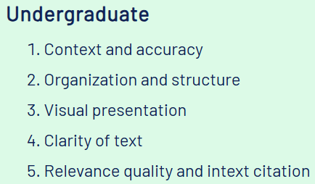
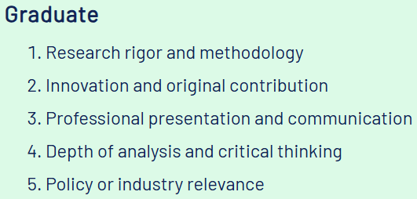
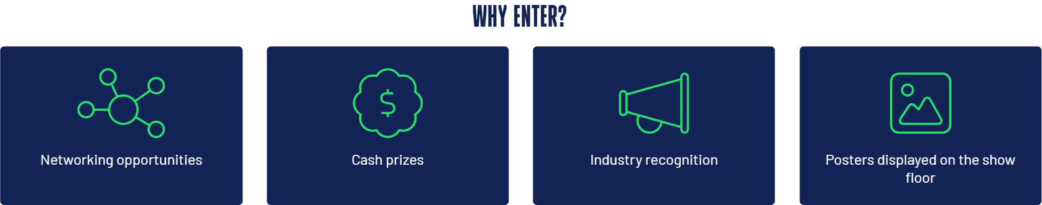
The Competition Judging Criteria
Posters will be reviewed by a panel of judges and scored on the following 5 criteria, each rated on a scale of 0 to 20 each (total 100 points). Two different sets of criteria apply to the two categories of submissions (undergraduate and graduate), as follows:

Slide 5


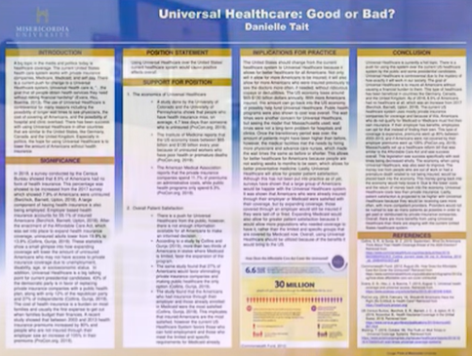
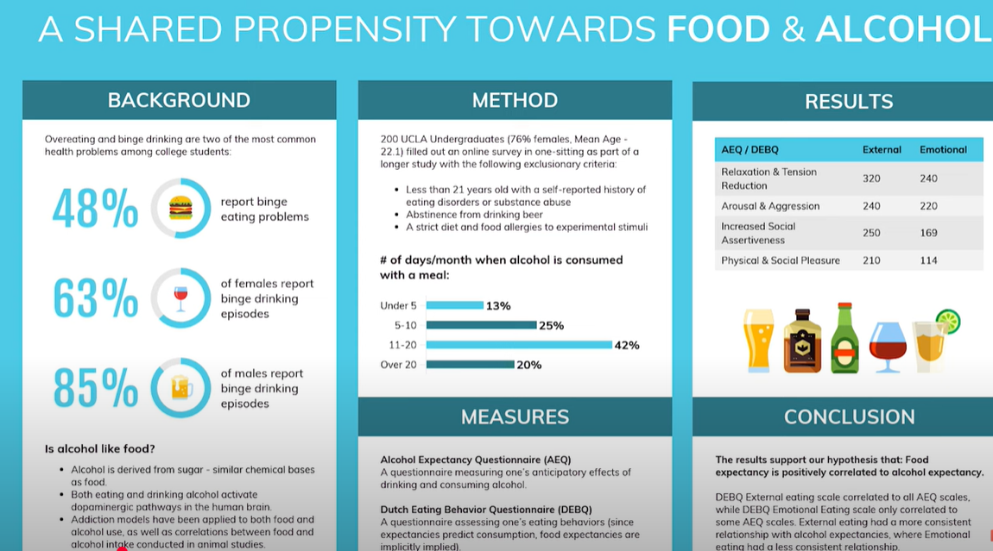
Research Poster “DOs” and “DON’T’s”
How to design an interesting and appealing research poster ?
Cut words, avoid the information clutter
Apply a logic flow of the idea, data, conclusions
Use Graphics and Figures that will grab attention (quick scan through)
Bold Title and Conclusions (avoid long wordy titles)
Find the right color pattern and combination, don’t abuse it.
Watch more detailed hints in this Video: What makes a great research poster?
[Good and Bad Examples] by Andy Stapleton at https://youtu.be/ZwiTqrVfDFU

Slide 6
Find your Industry Advisor
Name/ Company | Email
Jake Swanson - Regional Vice President – Americas Operations, DHL Industrial Projects | jacob.swanson@dhl.com
John Hark - Director - North America, Bertling Logistics Talon Felts - Sales Director Bertling Logistics | john.hark@bertling.com talon.felts@bertling.com
Peter Jessup - Supply Chain Consultant, Proactive Change LLC | peterjessup@me.com
Additional questions, please contact the Co-hosts:
Cassia Bomer Galvao (galvaoc@tamug.edu
Margaret Kidd (margaret.kidd@sjcd.edu )
Ivy Jenkins (ivy.jenkins@sjcd.edu )

Slide 7
Take a look a 2025 winners and their posters
Get Inspired by Our 2025 Entries
Explore the Top 20 shortlisted entries from our 2025 Student Research Poster Competition and see the innovative research, creative thinking and high-quality poster designs that impressed our judging panel.
Whether you're looking for ideas on layout, presentation or topic selection, these posters are a great source of inspiration as you begin preparing your entry for the 2026 competition.
https://americas.breakbulk.com/page/student-poster-competition-entries
Additional questions, please contact the Co-hosts:
Cassia Bomer Galvao (galvaoc@tamug.edu)
Margaret Kidd (margaret.kidd@sjcd.edu)
Ivy Jenkins (ivy.jenkins@sjcd.edu)

